Slide 1
DLD Online 1
Section A2 & B2

Slide 2
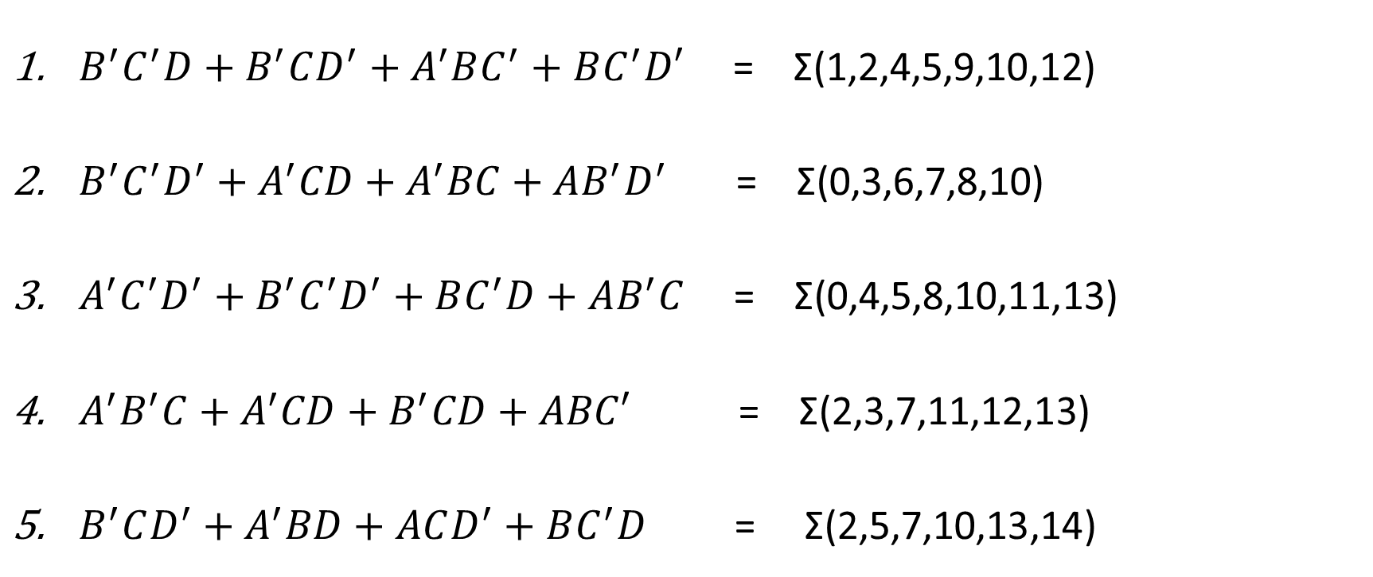
Consider there are four 1-bit Boolean inputs A,B,C and D. Implement the following Boolean functions using only the 7400-series IC chips: IC 74x04, IC 74x08 and IC 74x32 in your circuit.
Time: 30 minutes + 5 minutes to submit in Moodle.
$B^{′}C^{′}D+B^{′}CD^{′}+A^{′}BC^{′}+BC^{′}D′$ = Σ(1,2,4,5,9,10,12)
$B^{′}C^{′}D^{′}+A^{′}CD+A^{′}BC+AB^{′}D^{′}$ = Σ(0,3,6,7,8,10)
$A^{′}C^{′}D^{′}+B^{′}C^{′}D^{′}+BC^{′}D+AB^{′}C$ = Σ(0,4,5,8,10,11,13)
$A^{′}B^{′}C+A^{′}CD+B^{′}CD+ABC′$ = Σ(2,3,7,11,12,13)
$B^{′}CD^{′}+A^{′}BD+ACD^{′}+BC^{′}D$ = Σ(2,5,7,10,13,14)

